Slide 1
CSC479
Data Mining
Classification Lecture 8
Model Evaluation
(Ch # 8: Data Mining-Concepts and Techniques by Han and Kamber)

Slide 2
Practical Issues of Classification
Underfitting and Overfitting
Evaluation

Slide 3
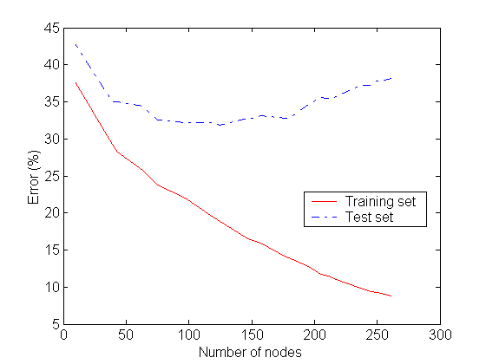
Underfitting and Overfitting
Underfitting
Overfitting
Underfitting: when model is too simple, both training and test errors are large
Overfitting: when model is too complex it models the details of the training set and fails on the test set

Slide 4
Notes on Overfitting
Overfitting results in decision trees that are more complex than necessary
Training error no longer provides a good estimate of how well the tree will perform on previously unseen records
The model does not generalize well
Need new ways for estimating errors

Slide 5
How to Address Overfitting: Tree Pruning
Pre-Pruning (Early Stopping Rule)
Stop the algorithm before it becomes a fully-grown tree
Typical stopping conditions for a node:
Stop if all instances belong to the same class
Stop if all the attribute values are the same
More restrictive conditions:
Stop if number of instances is less than some user-specified threshold
Stop if class distribution of instances are independent of the available features (e.g., using χ ² test)
Stop if expanding the current node does not improve impurity measures (e.g., Gini or information gain) or it falls below a threshold value.
Upon halting, the node becomes a leaf
The leaf may hold the most frequent class among the subset tuples.
Problem
Difficult to choose an appropriate threshold

Slide 6
How to Address Overfitting…
Post-pruning
Grow decision tree to its entirety
Trim the nodes of the decision tree in a bottom-up fashion
If generalization error improves after trimming, replace sub-tree by a leaf node.
Class label of leaf node is determined from majority class of instances in the sub-tree

Slide 7
Prune the Tree OR Prune the Rule
In order to Reduce the complexity of decision procedure we have two options (i) either we can prune the tree first and then develop the rules or (ii) we can develop the rules and then prune the rules.
Which is better?
(ii) is better, why?

Slide 8
Model Evaluation
Metrics for Performance Evaluation
How to evaluate the performance of a model?
Methods for Performance Evaluation
How to obtain reliable estimates?

Slide 9
Model Evaluation
Metrics for Performance Evaluation
How to evaluate the performance of a model?
Methods for Performance Evaluation
How to obtain reliable estimates?

Slide 10
Classifier Evaluation Metrics: Confusion Matrix
Confusion Matrix:
Actual class\Predicted class | C₁ | ¬ C₁
C₁ | True Positives (TP) | False Negatives (FN)
¬ C₁ | False Positives (FP) | True Negatives (TN)
Example of Confusion Matrix:
Actual class\Predicted class | buy_computer = yes | buy_computer = no | Total
buy_computer = yes | 6954 | 46 | 7000
buy_computer = no | 412 | 2588 | 3000
Total | 7366 | 2634 | 10000
Given m classes, an entry, CM_{i,j} in a confusion matrix indicates # of tuples in class i that were labeled by the classifier as class j
May have extra rows/columns to provide totals
10

Slide 11
Limitation of Accuracy
Consider a 2-class problem
Number of Class 0 examples = 9990
Number of Class 1 examples = 10
If model predicts everything to be class 0, accuracy is 9990/10000 = 99.9 %
Accuracy is misleading because model does not detect any class 1 example

Slide 12
Classifier Accuracy, Error Rate, Sensitivity Specificity
A\P | C | ¬C
C | TP | FN | P
¬C | FP | TN | N
 | P’ | N’ | All
Class Imbalance Problem:
One class may be rare, e.g. fraud, or HIV-positive
Significant majority of the negative class and minority of the positive class
Sensitivity: True Positive recognition rate
Sensitivity = TP/P
Specificity: True Negative recognition rate
Specificity = TN/N
Classifier Accuracy, or recognition rate: percentage of test set tuples that are correctly classified
Accuracy = (TP + TN)/All
Error rate: 1 – accuracy, or
Error rate = (FP + FN)/All
12

Slide 13
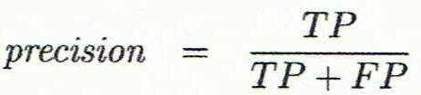
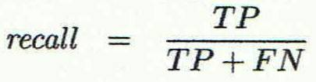
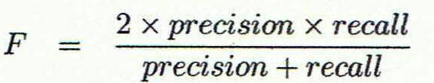
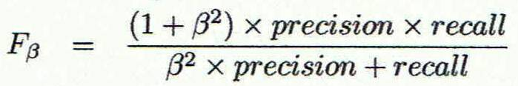
Classifier Evaluation Metrics: Precision and Recall, and F-measures
Precision: exactness – what % of tuples that the classifier labeled as positive are actually positive
Recall: completeness – what % of positive tuples did the classifier label as positive?
Perfect score is 1.0
Inverse relationship between precision & recall
F measure (F₁ or F-score): harmonic mean of precision and recall,
F_{ß}: weighted measure of precision and recall
assigns ß times as much weight to recall as to precision
13

Slide 14
Classifier Evaluation Metrics: Example
Actual Class\Predicted class | cancer = yes | cancer = no | Total | Recognition(%)
cancer = yes | 90 | 210 | 300 | 30.00 (sensitivity
cancer = no | 140 | 9560 | 9700 | 98.56 (specificity)
Total | 230 | 9770 | 10000 | 96.40 (accuracy)
Precision = 90/230 = 39.13% Recall = 90/300 = 30.00%
14

Slide 15
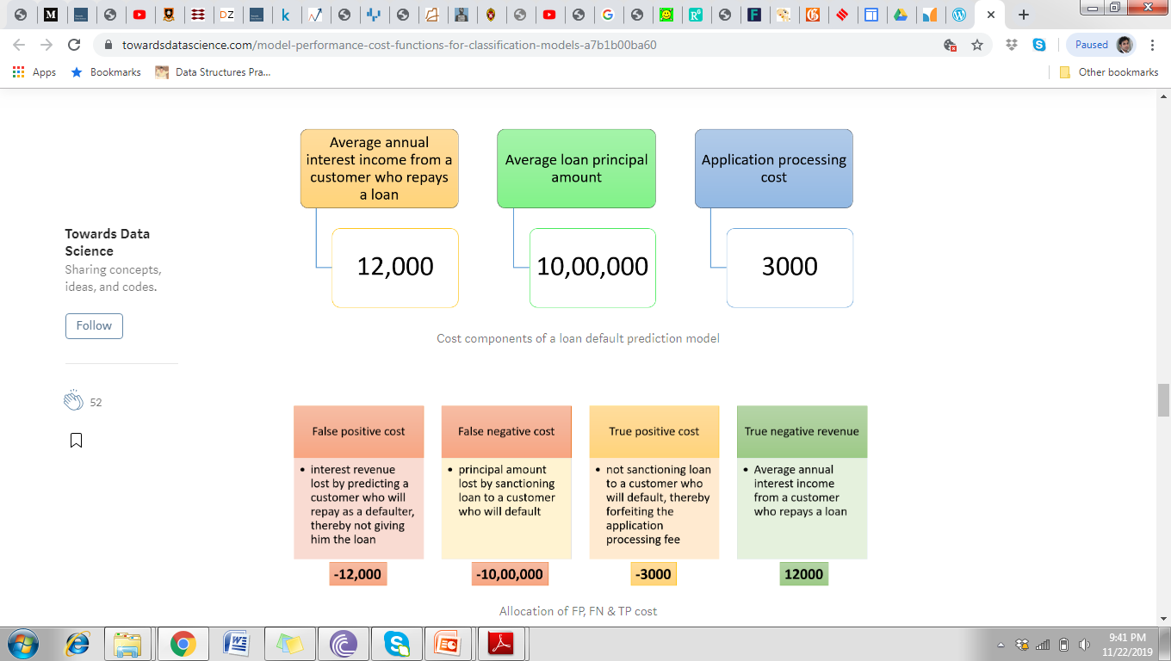
Computing Cost of Classification
Notes:
https://towardsdatascience.com/model-performance-cost-functions-for-classification-models-a7b1b00ba60

Slide 16
Computing Cost of Classification
Cost Matrix | PREDICTED CLASS
ACTUAL CLASS | C(i|j) | + | -
 | + | -1 | 100
 | - | 1 | 0
Model M₁ | PREDICTED CLASS
ACTUAL CLASS |  | + | -
 | + | 150 | 40
 | - | 60 | 250
Model M₂ | PREDICTED CLASS
ACTUAL CLASS |  | + | -
 | + | 250 | 45
 | - | 5 | 200
Accuracy = 80%
Cost = 3910
Accuracy = 90%
Cost = 4255

Slide 17
Cost vs Accuracy
Count | PREDICTED CLASS
ACTUAL CLASS |  | Class=Yes | Class=No
 | Class=Yes | a | b
 | Class=No | c | d
Accuracy is proportional to cost if 1. C(Yes|No)=C(No|Yes) = q 2. C(Yes|Yes)=C(No|No) = p
N = a + b + c + d
Accuracy = (a + d)/N
Cost = p (a + d) + q (b + c)
= p (a + d) + q (N – a – d)
= q N – (q – p)(a + d)
= N [q – (q-p) × Accuracy]
Cost | PREDICTED CLASS
ACTUAL CLASS |  | Class=Yes | Class=No
 | Class=Yes | p | q
 | Class=No | q | p

Slide 18
Precision-Recall
Count | PREDICTED CLASS
ACTUAL CLASS |  | Class=Yes | Class=No
 | Class=Yes | a | b
 | Class=No | c | d
Precision is biased towards C(Yes|Yes) & C(Yes|No)
Recall is biased towards C(Yes|Yes) & C(No|Yes)
F-measure is biased towards all except C(No|No)

Slide 19
Precision-Recall plot
Precision-Recall is a useful measure of success of prediction when the classes are very imbalanced. In information retrieval, precision is a measure of result relevancy, while recall is a measure of how many truly relevant results are returned.

Slide 20
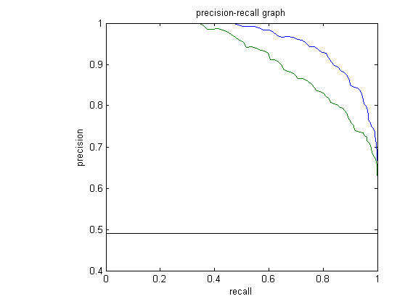
Precision-Recall plot
It shows the tradeoff between precision and recall for different threshold. A high area under the curve represents both high recall and high precision

Slide 21
Precision-Recall plot
high precision relates to a low false positive rate, and high recall relates to a low false negative rate. High scores for both show that the classifier is returning accurate results (high precision), as well as returning a majority of all positive results (high recall).

Slide 22
Precision-Recall plot
A system with high recall but low precision returns many results, but most of its predicted labels are incorrect when compared to the training labels. A system with high precision but low recall is just the opposite, returning very few results, but most of its predicted labels are correct when compared to the training labels.

Slide 23
Precision-Recall plot
An ideal system with high precision and high recall will return many results, with all results labeled correctly.

Slide 24
Evaluating Classifier Accuracy: Holdout & Cross-Validation Methods
Holdout method
Given data is randomly partitioned into two independent sets
Training set (e.g., 2/3) for model construction
Test set (e.g., 1/3) for accuracy estimation
Random sampling: a variation of holdout
Repeat holdout k times, accuracy = avg. of the accuracies obtained
Cross-validation (k-fold, where k = 10 is most popular)
Randomly partition the data into k mutually exclusive subsets, each approximately equal size
At i-th iteration, use D_{i} as test set and others as training set
Leave-one-out: k folds where k = # of tuples, for small sized data
*Stratified cross-validation*: folds are stratified so that class dist. in each fold is approx. the same as that in the initial data
24

Slide 25
Model Evaluation
Metrics for Performance Evaluation
How to evaluate the performance of a model?
Methods for Performance Evaluation
How to obtain reliable estimates?

Slide 26
Methods for Performance Evaluation
How to obtain a reliable estimate of performance?
Performance of a model may depend on other factors besides the learning algorithm:
Class distribution
Cost of misclassification
Size of training and test sets

Slide 27
Dealing with class Imbalance
If the class we are interested in is very rare, then the classifier will ignore it.
The class imbalance problem
Solution
We can modify the optimization criterion by using a cost sensitive metric
We can balance the class distribution
Sample from the larger class so that the size of the two classes is the same
Replicate the data of the class of interest so that the classes are balanced
Over-fitting issues

Slide 28
Classification of Class-Imbalanced Data Sets
Typical methods for imbalance data in 2-class classification:
Oversampling: re-sampling of data from positive class
Under-sampling: randomly eliminate tuples from negative class
Threshold-moving: moves the decision threshold, t, so that the rare class tuples are easier to classify, and hence, less chance of costly false negative errors
Ensemble techniques: Ensemble multiple classifiers introduced above
Still difficult for class imbalance problem on multiclass tasks
28

